Slide 1
High-speed imaging
Claus-Dieter Ohl

Slide 2
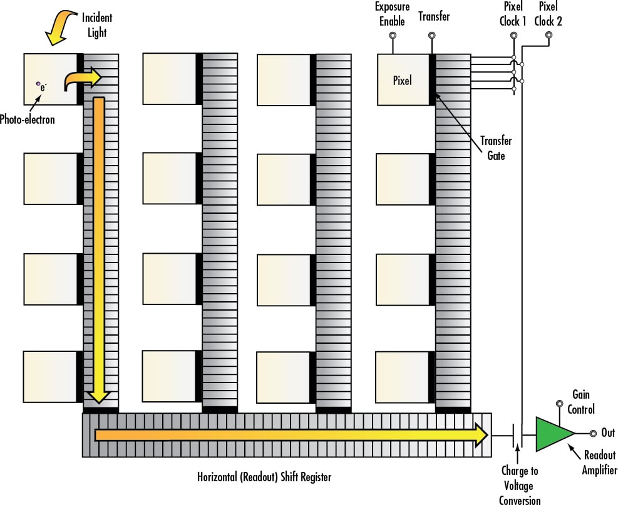
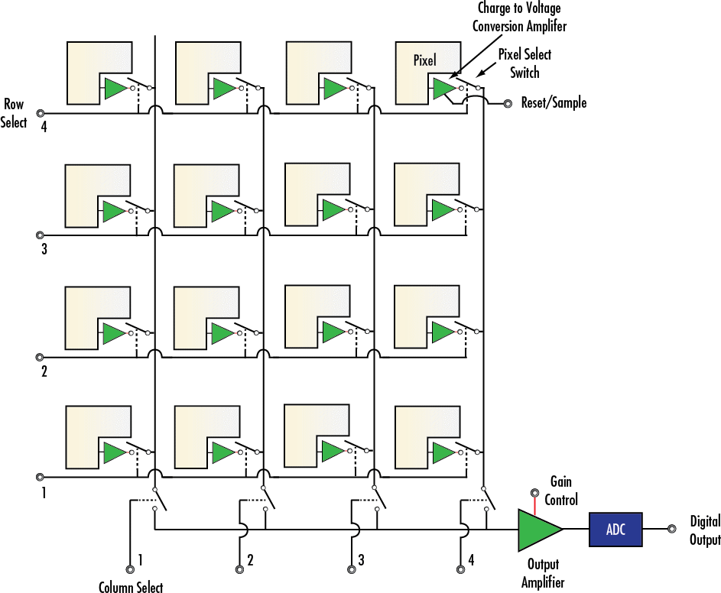
CCD vs. CMOS sensors

Slide 3
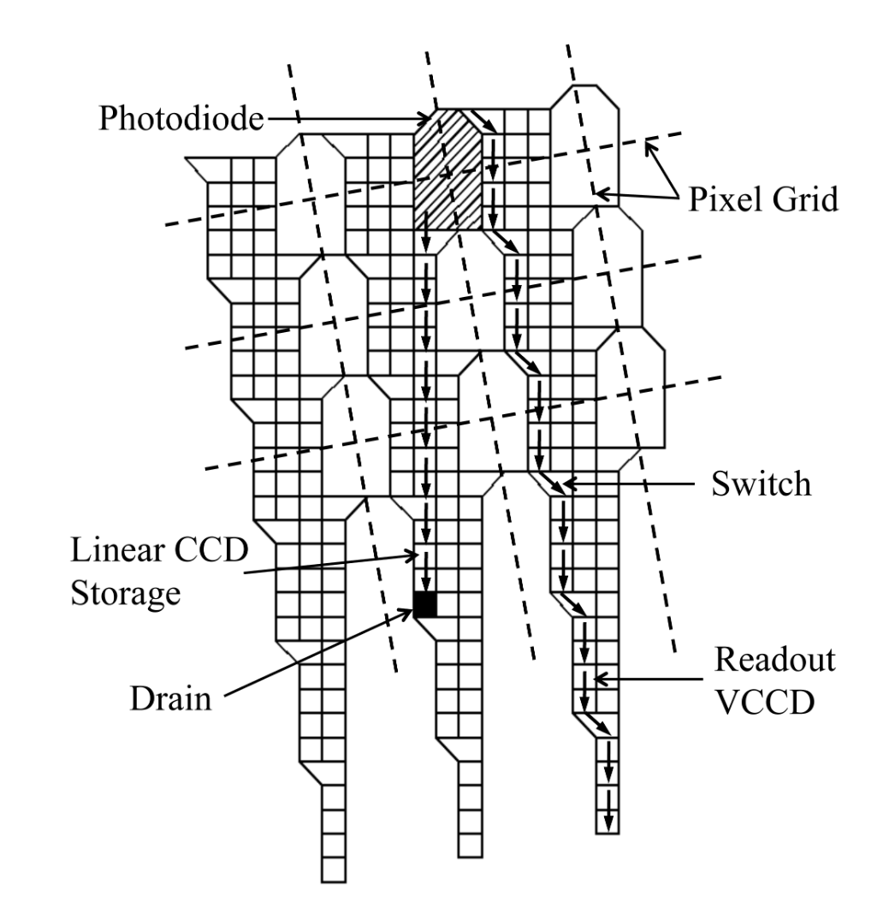
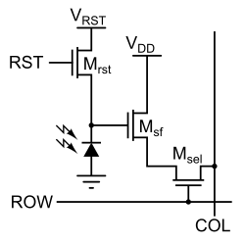
Single CMOS pixels
Storage CCD sensor
of the Shimadzu HPV 1
https://en.wikipedia.org/wiki/Active-pixel_sensor

Slide 4
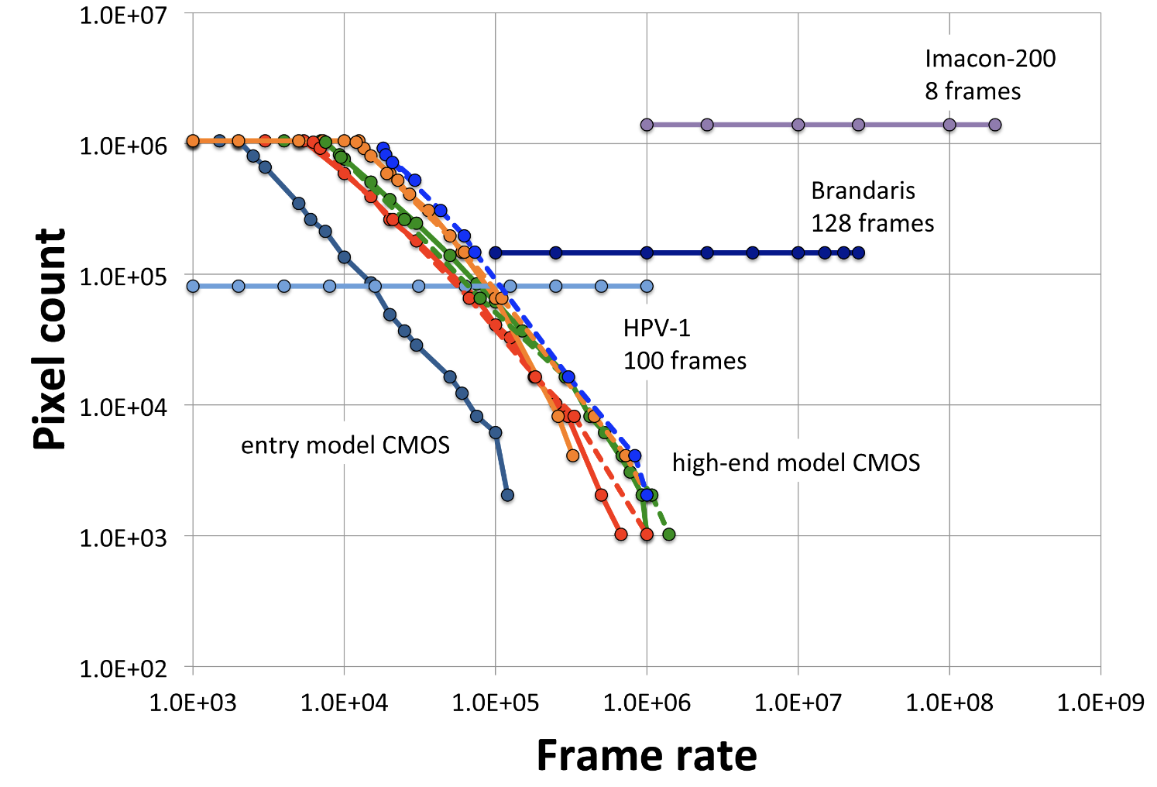
Full frame, CMOS and single image cameras
HPV X-2
128 frames
Pharsighted
continous imaging
M. Versluis, Exp. Fluids (2013)

Slide 5
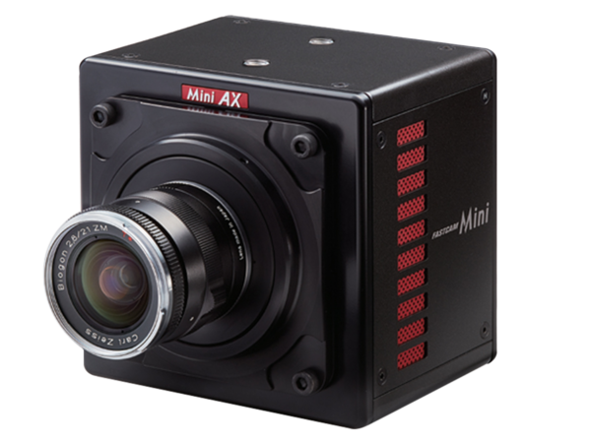
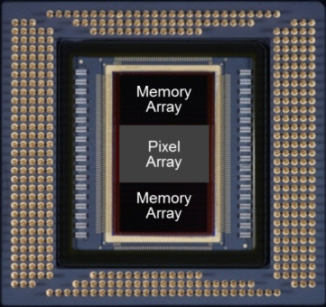
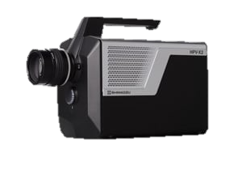
CMOS based high-speed cameras
Photron Mini AX200:
Up to 900,000 frames/s
Shimadzu HPV X-2
Up to 10 million frames/s

Slide 6
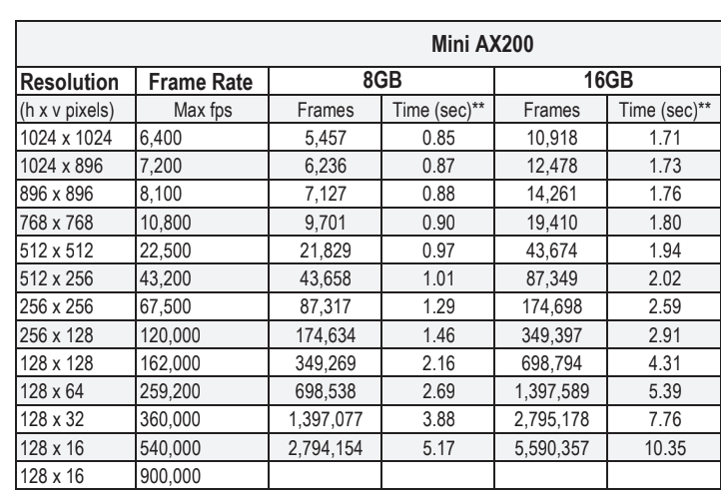

Slide 7
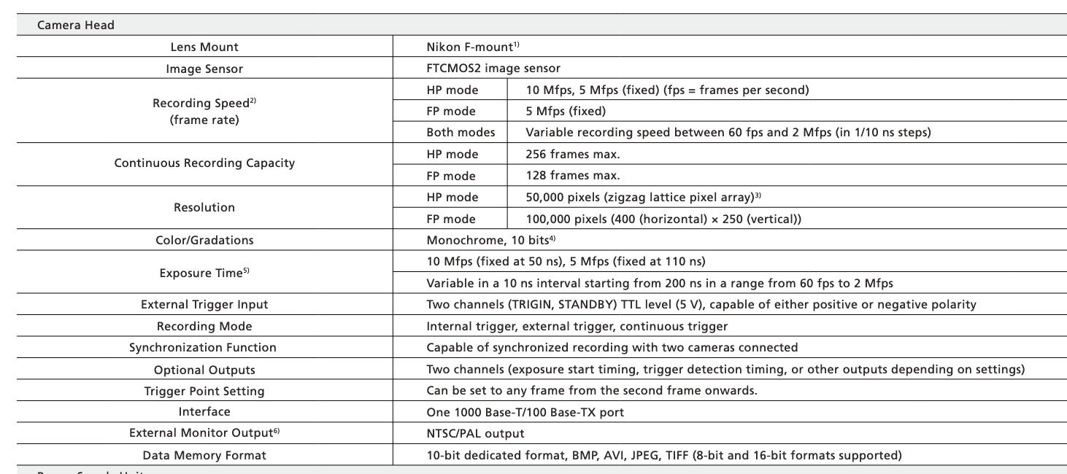
Shimadzu HPV X-2

Slide 8
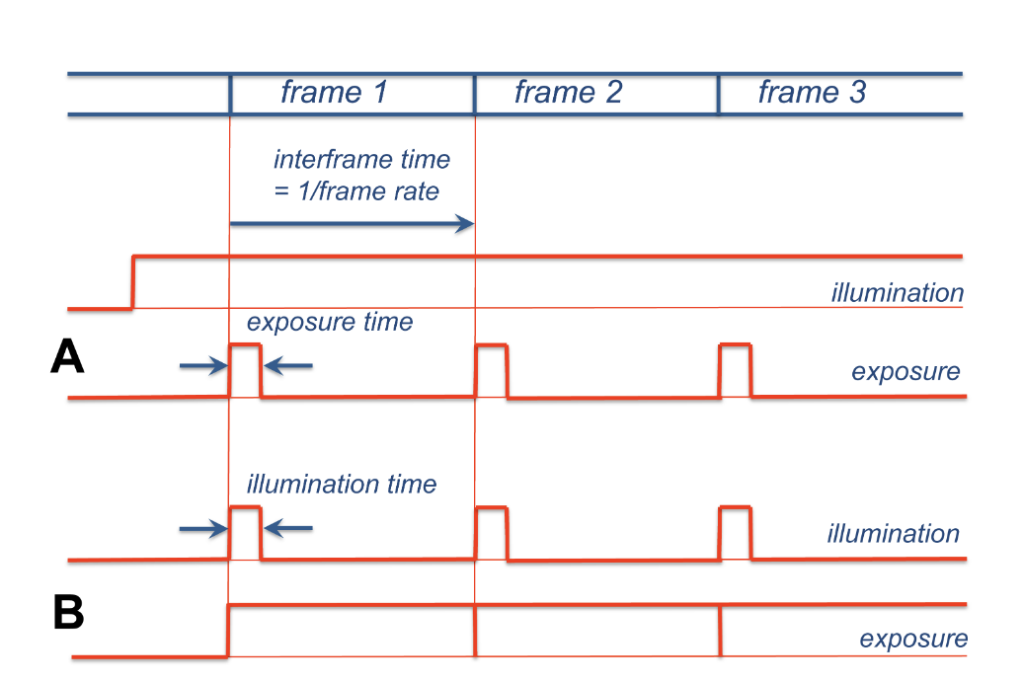

Slide 9
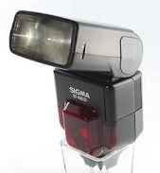
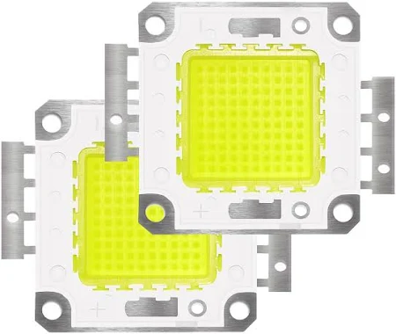
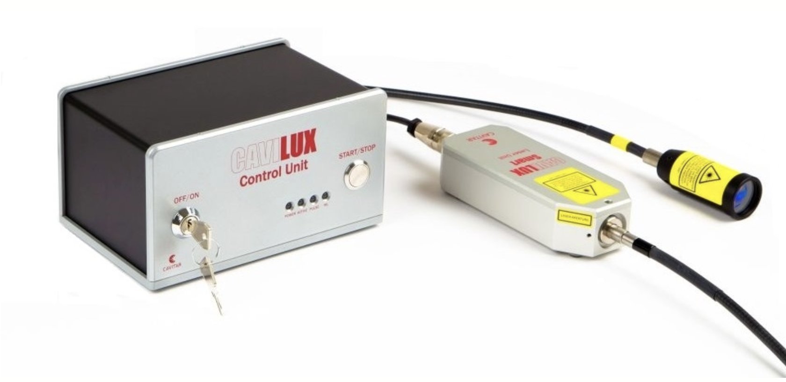
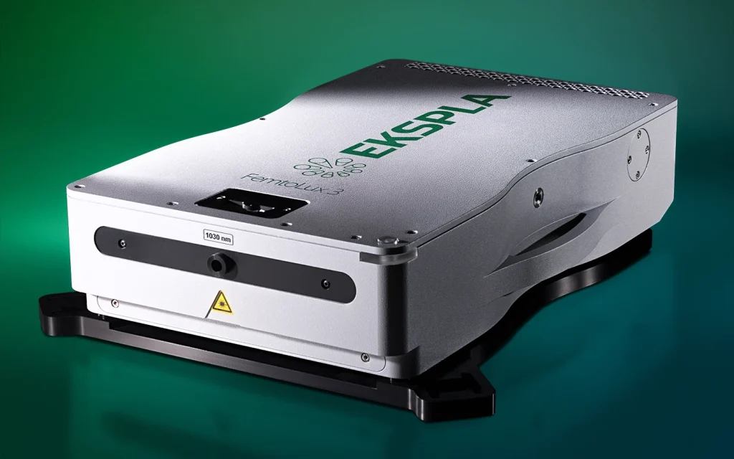
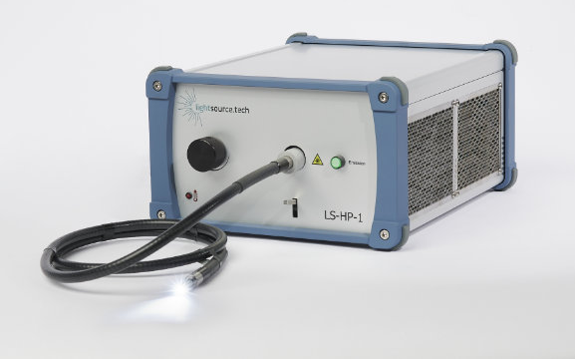
Light Sources
Pulsed laser diode based light source
Pulse duration about 10ns
LED up to 100W
electrical power
Continuous wave LED based light source
Light transmitted through liquid light guide
fs and ps high repetition rate lasers, coupled into
multimode glass fiber up to 10MHz

